Slide 1

The training environment

Slide 2
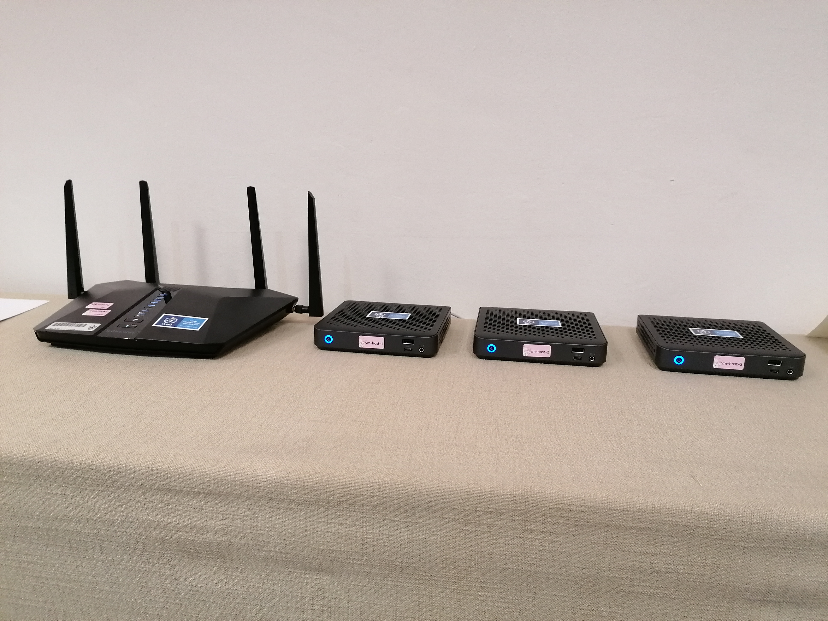
Local training environment
WiFi Router + 3 Mini PCs running ProxMox virtualization platform
Dedicated Student VM for each participant available on the local WiFi network in this room:
SSID=WIS2-training
password=dataismagic!

Slide 3
Student VM
Virtualization Platform
The practical exercises for the WIS2box-training require you to use your Student VM
VM hardware:
2 vCPUs, 4 GB Memory, 48 GB local storage (SSD)
VM software:
Operating System: Ubuntu 20.04.5 LTS
Docker version 20.10.17, docker-compose version 1.29.2
Python 3.8.10
Basic tools: unzip, wget, curl
cmd-line-editors: nano, vi, vim, emacs
mosquitto_sub, mosquitto_pub
Student-VM (Linux/Docker)
csv2bufr
container
synop2bufr
container

Slide 4
Your Student VM on the WIS2-training network
Access your personal student-VM using PuTTy (or any other SSH-client on your laptop)
Host: country-lastname.wis2box.training
Port: 22
Username: lastname
Password: namibia2023

Slide 5
Practical session
Access via Link provided in the Agenda

Slide 6
Thank you
Merci

